Slide 2
Project 01
After learning about Git and its operations, it is now time to implement the knowledge gained in a real development environment.
Read the question carefully, before attempting.
All the best!

Slide 3
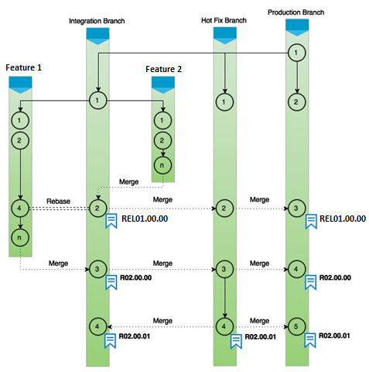
Project 01
Problem
Analysis
Instructions
Build a branching model as depicted in this figure
Click each tab to know more.

Slide 4
Project 01
Problem
Analysis
Instructions
Steps to perform the task:
Start with the production branch and then create a HotFix branch and Integration branch
Subsequently have Feature 1 and 2 branches integrate as shown in the figure
Ultimately integrate all features into HotFix branch and then into Production branch
Click each tab to know more. Click the Resources tab to download the files for this project.

Slide 5
Project 01
Problem
Analysis
Instructions
This project is a part of your assessment.
Perform the project and submit the solution.
Good Luck!
Click each tab to know more.

